Slide 1
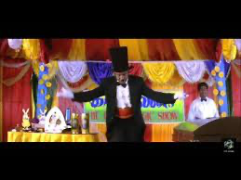

WELCOME
Topic : Social Distance monitoring using Ai
By : Balamuralikrishnaa.G.S
Guruprasath
Gowtham

Slide 2
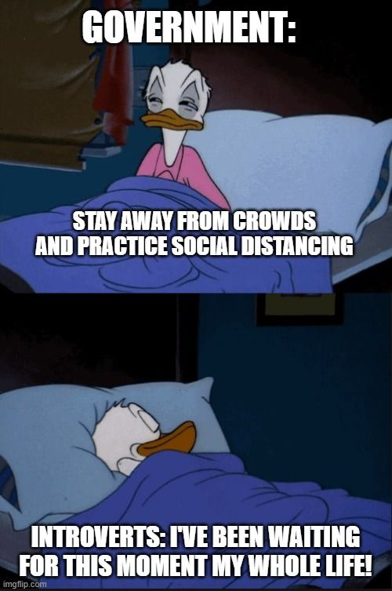
What is Social distaaaancing?
In Simple words
Don’t stand too close to anyone .

Slide 3
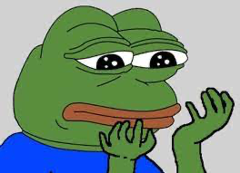
Why Social Distancing ?
So that u dont get any disease
and suffer during the pandemic.
Your family needs u so
Please follow the rules

Slide 4
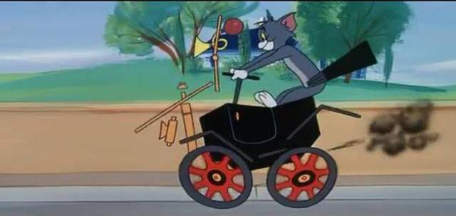
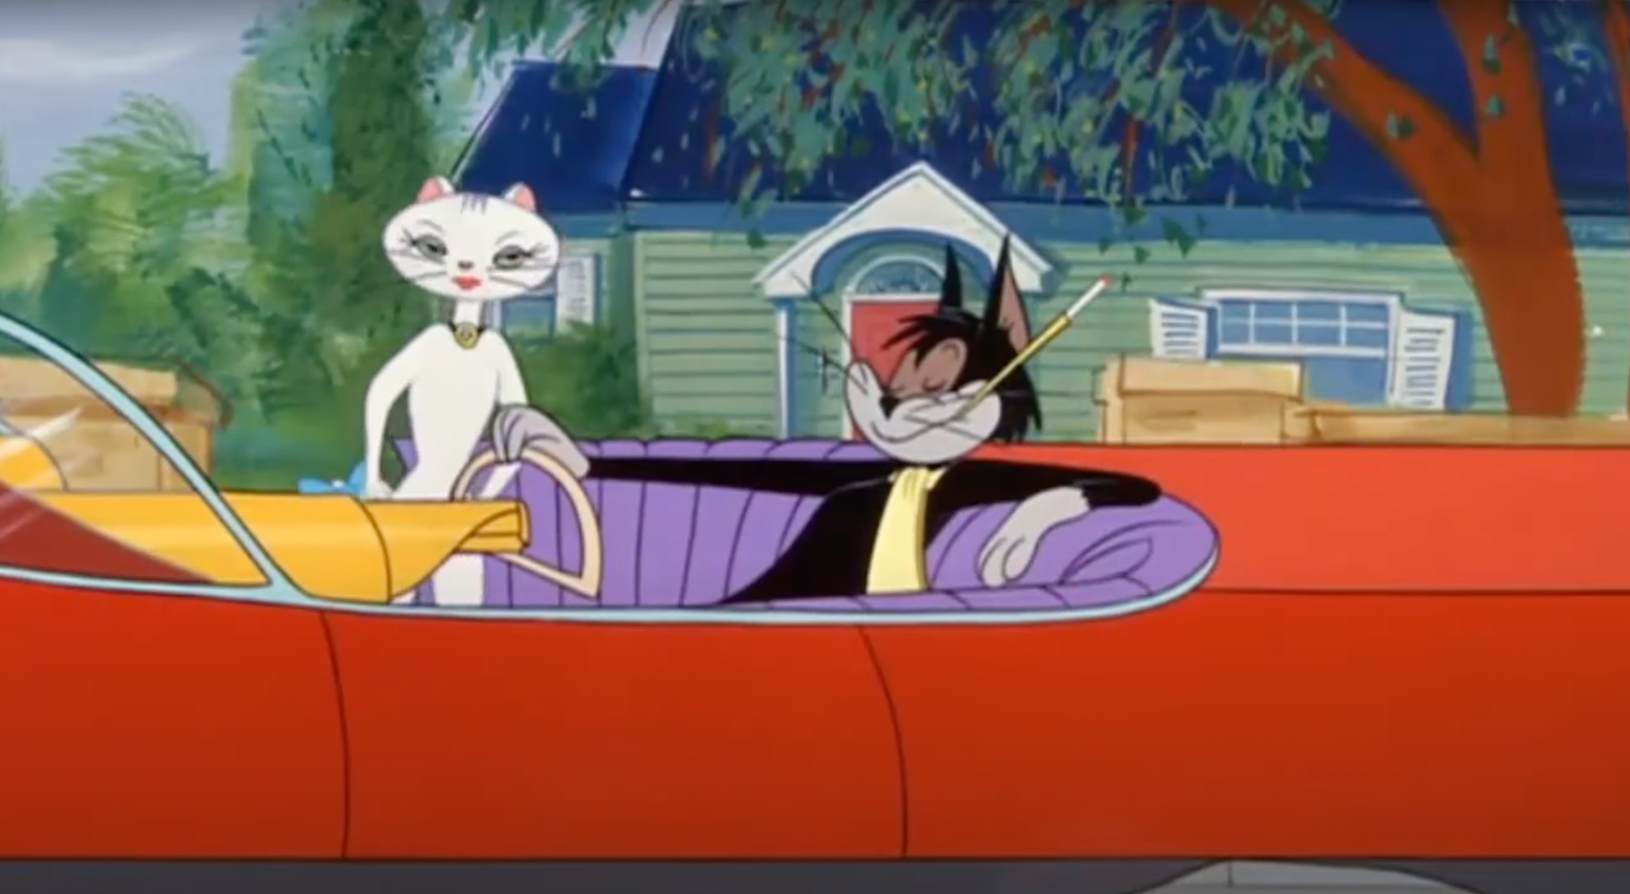
How does Ai help here?
*Lé Humans
Faster than Human
Can monitor huge crowd
Low error rate
*Ai

Slide 5
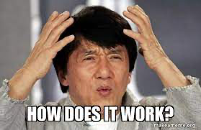
How it works?

Slide 6
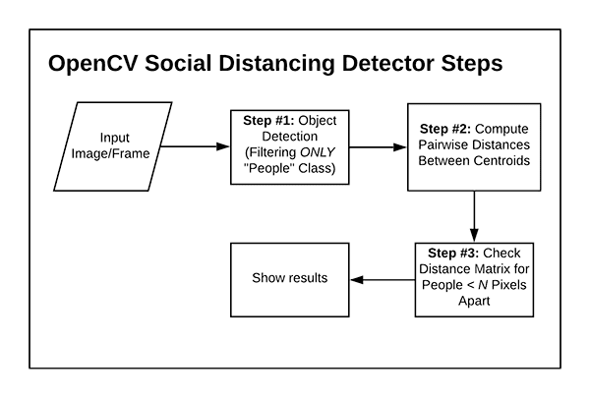

Slide 7

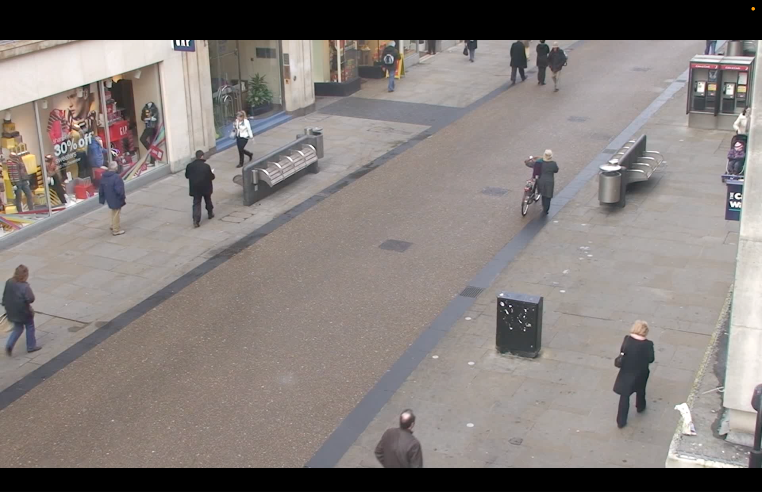
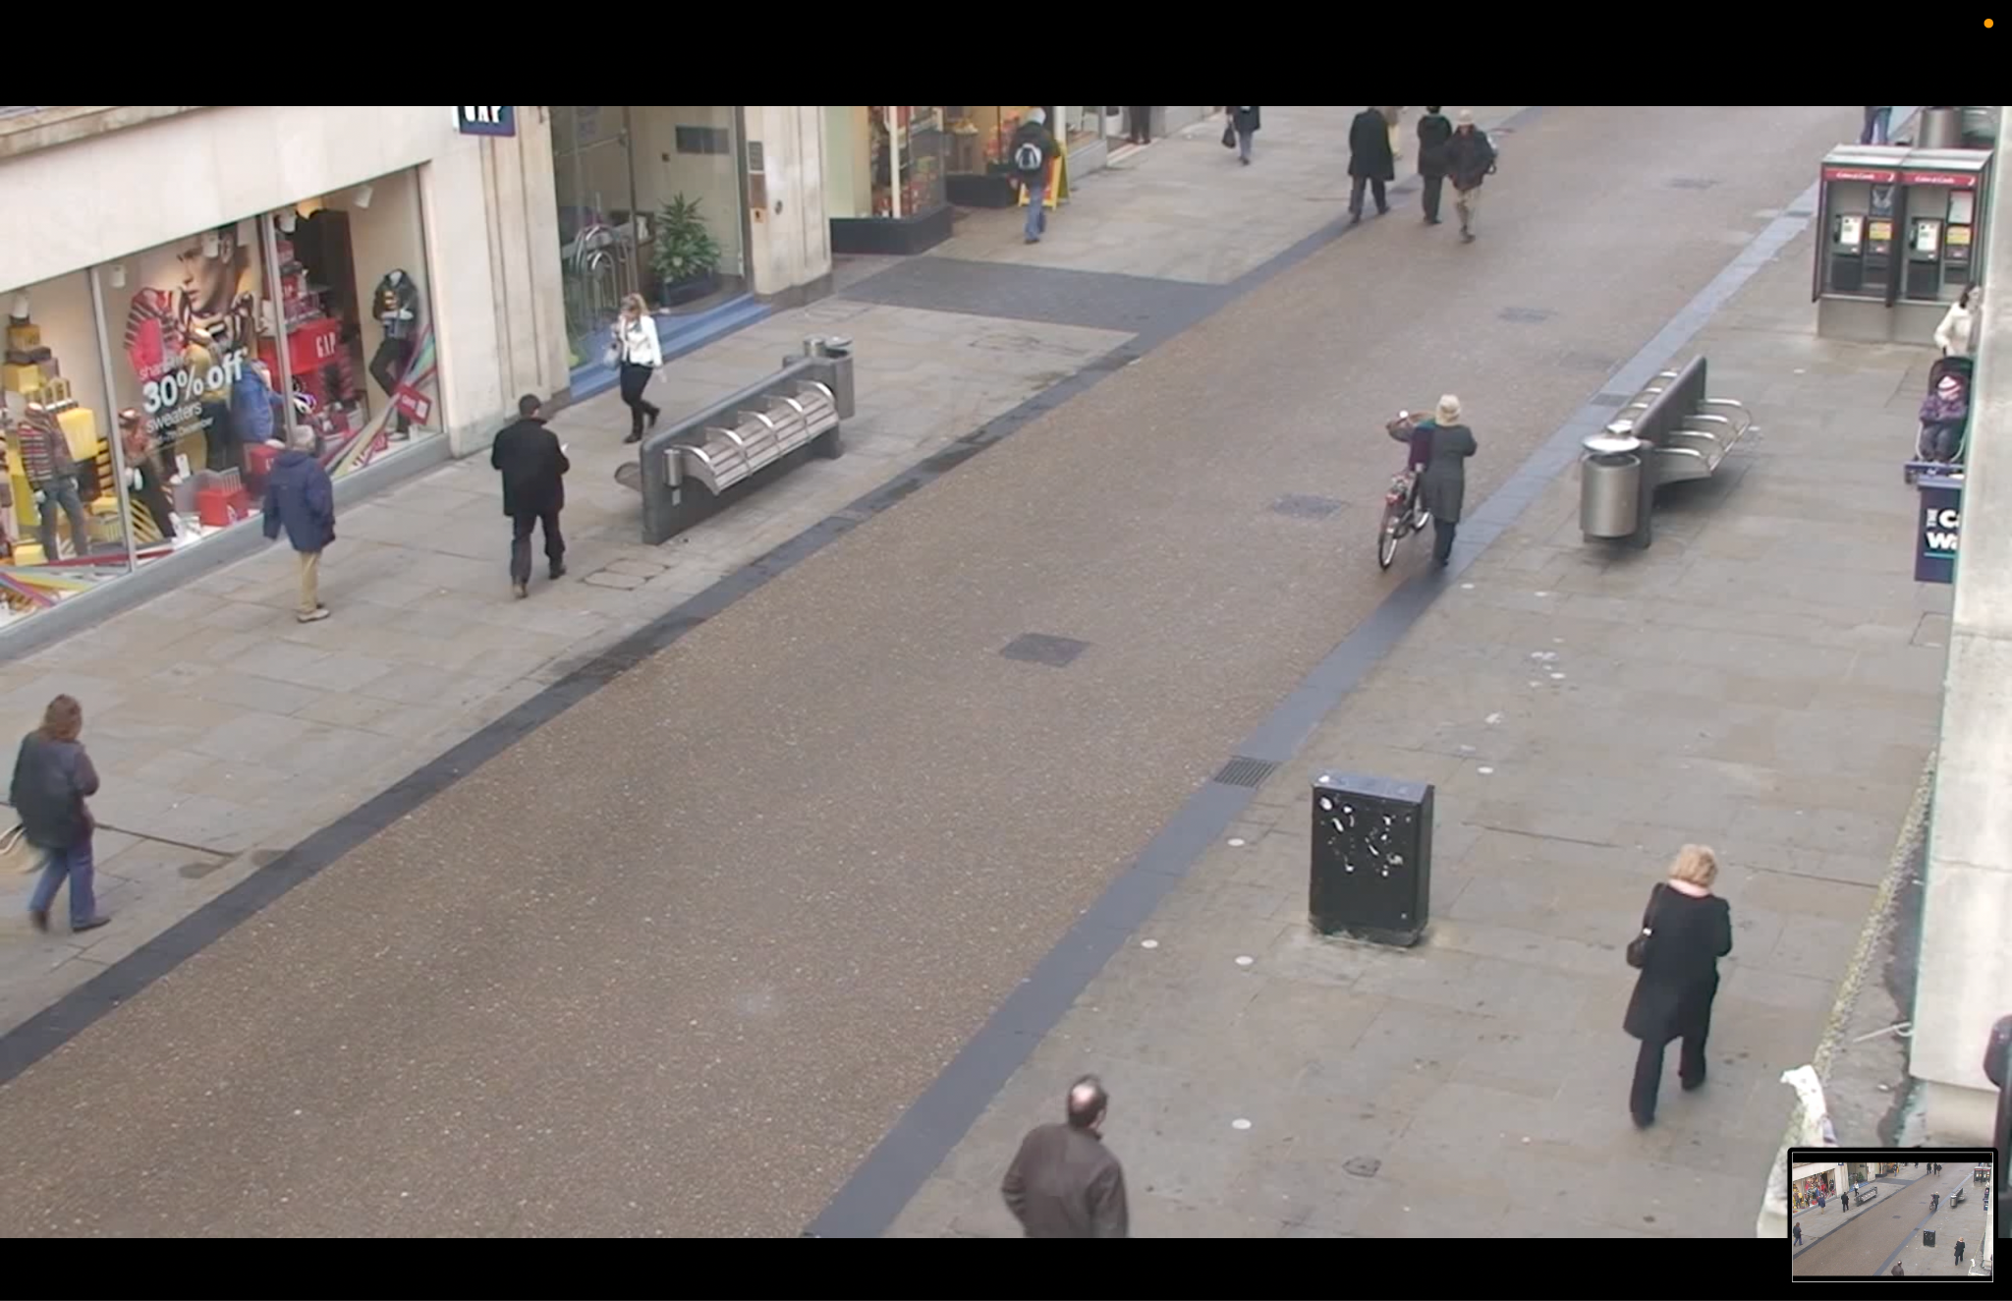
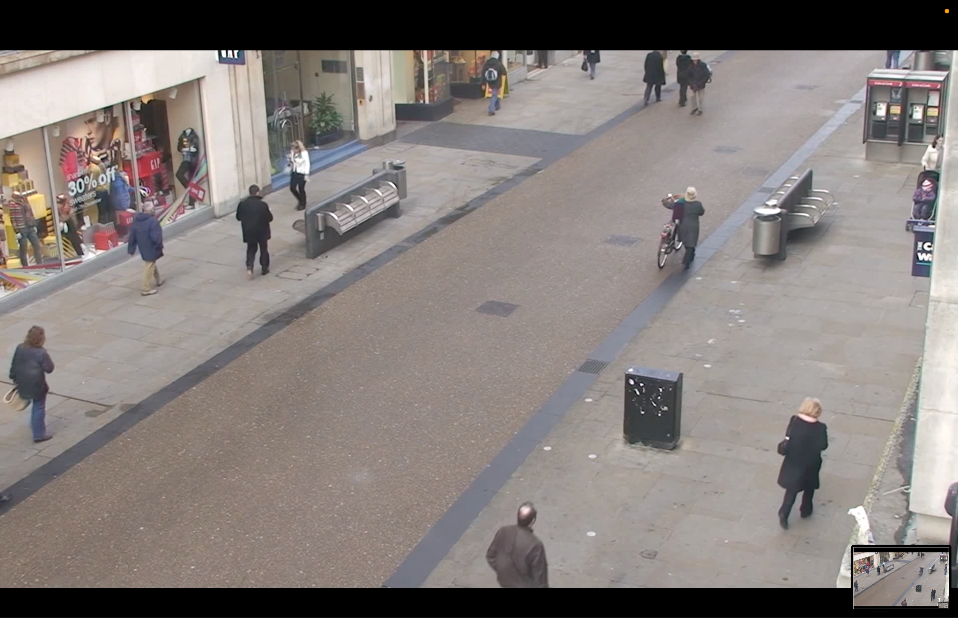
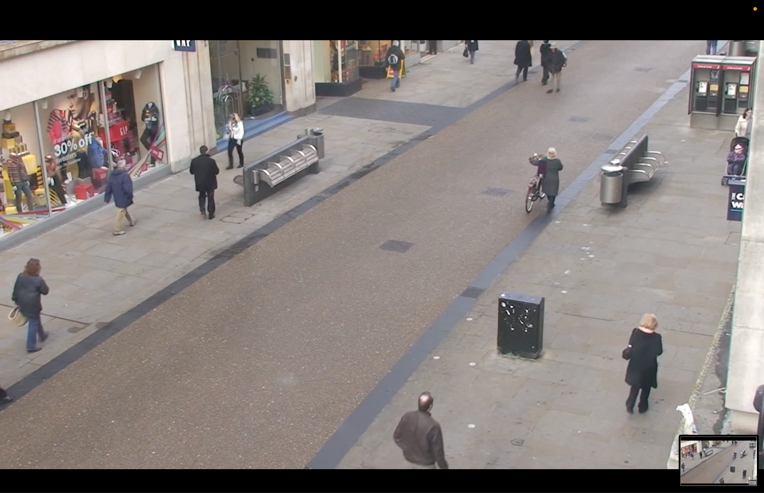

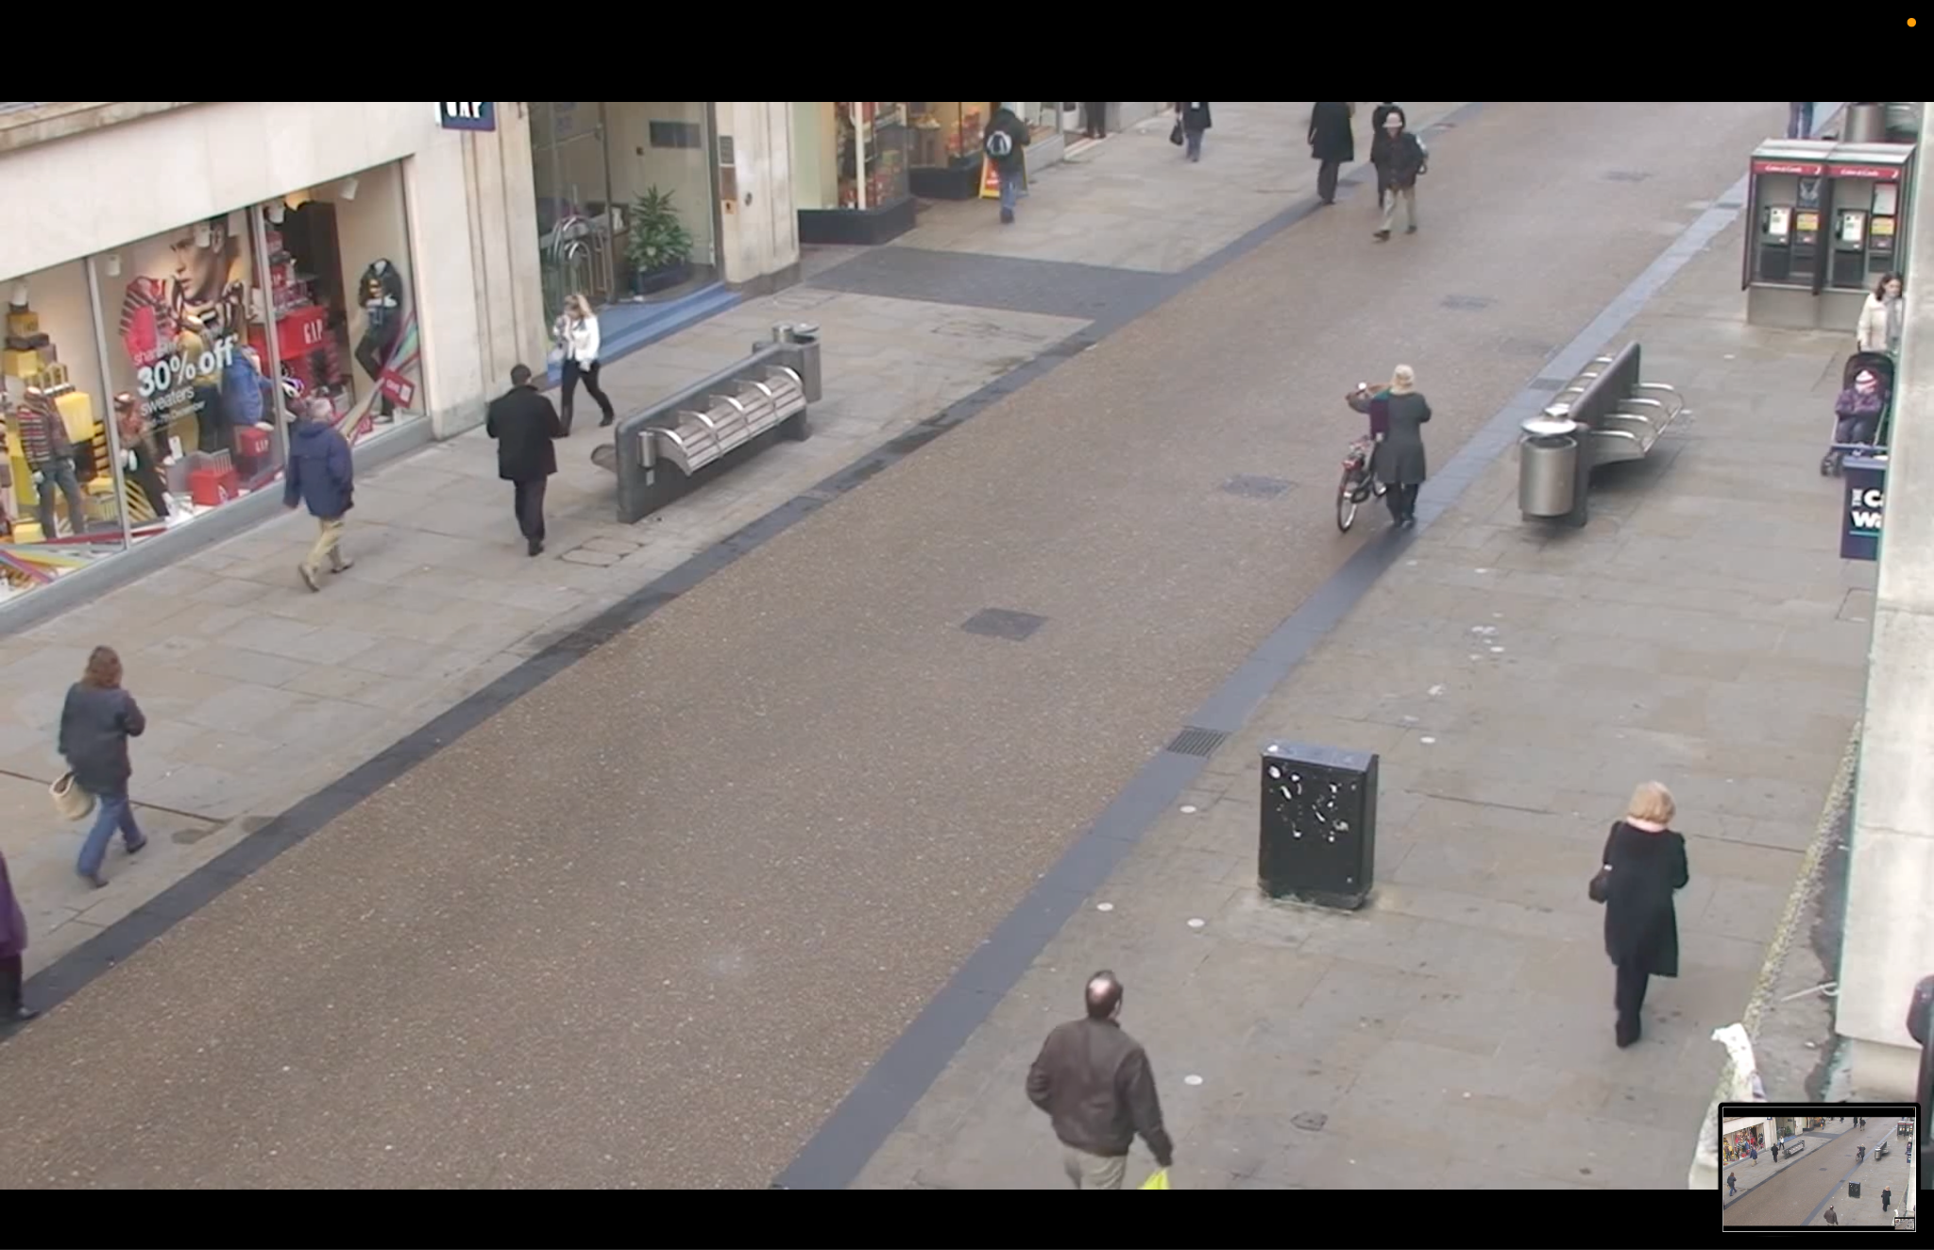

Slide 8
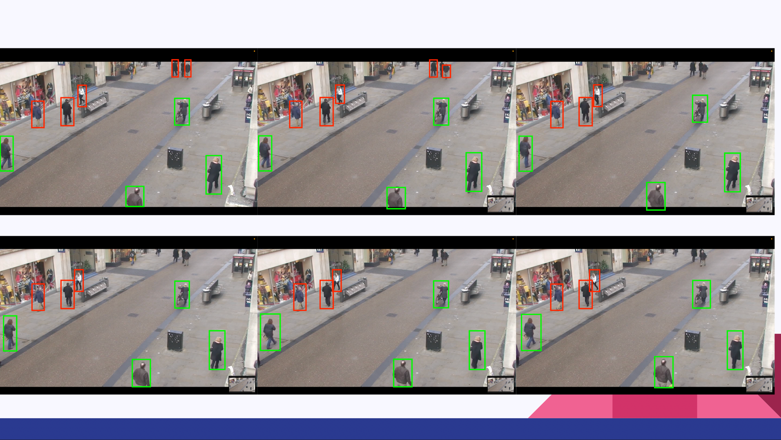

Slide 9

Thank You

